Slide 1
Further Expansions
Module 2.06 from BlackHat Training
Trainer: Colin O’Flynn

Slide 2
Overview
Background to Development
Synchronous Sampling
Connecting CW To Target Device
Voltage Translators
Serial IO
Programming the AVR
Software
Overview of two parts
Overview of project files
About scripting
About special scripts
Capture Software
Analysis Software
FPGA Project

Slide 3
Objectives
Introduce ChipWhisperer System
Comparison of ChipWhisperer System to Existing
Learn important details of connecting hardware
Learn software methodology

Slide 4
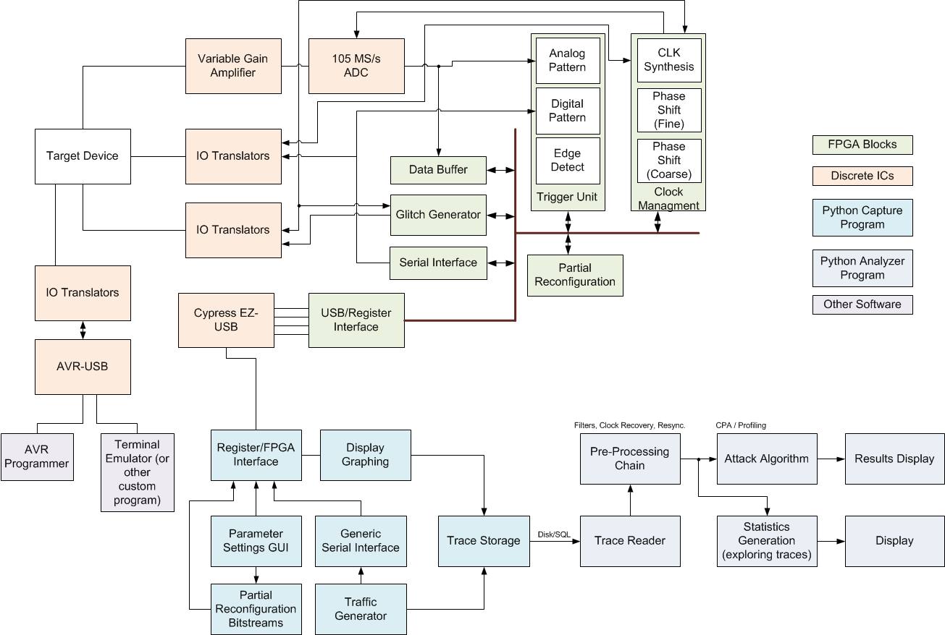
A Simple Block Diagram…

Slide 5
Clock Routing Inside the FPGA

Slide 6
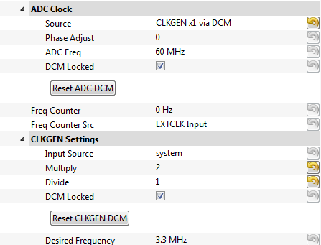
Clock Routing GUI

Slide 7
Input Clock Limits
Limits inside Spartan 6 FPGA used by ChipWhisperer
Generally ~5MHz LOWER limit on clock frequencies!
Can use external PLL instead to improve this

Slide 8
Input Clock Limits
Can get lower frequencies if you are careful (requires changes to FPGA design!):

Slide 9
Output Clock Limits
Can get lower frequencies if you are careful (requires changes to FPGA design!):

Slide 10
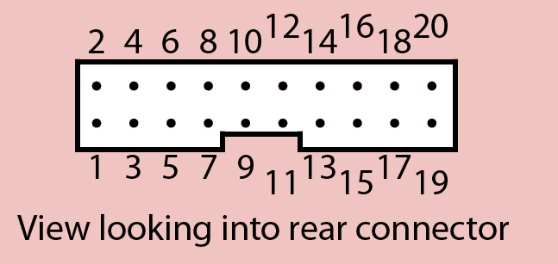
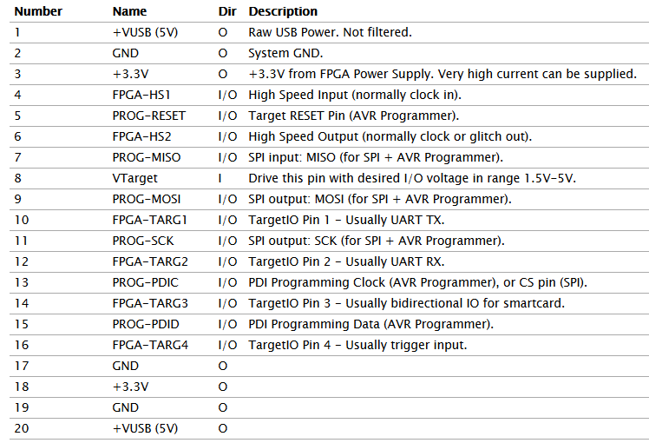
Physical Connections

Slide 11
FPGA-Controlled Target-IO Lines
Purpose: Medium speed digital IO, controlled by FPGA project.
Specs: 4 IO lines, bi-directional including open-drain support (e.g. I²C). FPGA can choose to drive lines using push-pull (faster IO) or open-drain.
Examples:
Interface for Target communication
Trigger Lines

Slide 12
FPGA-Controlled High-Speed Lines
Purpose: Very high speed digital IO for clocks, controlled by FPGA.
Specs: 2 IO lines, bi-directional but must set direction from FPGA (e.g. another line sets if input or output). VERY FAST slew rate, be careful of ringing.
Examples:
Clock Input from Target
Clock Output to Target
Glitch Output

Slide 13
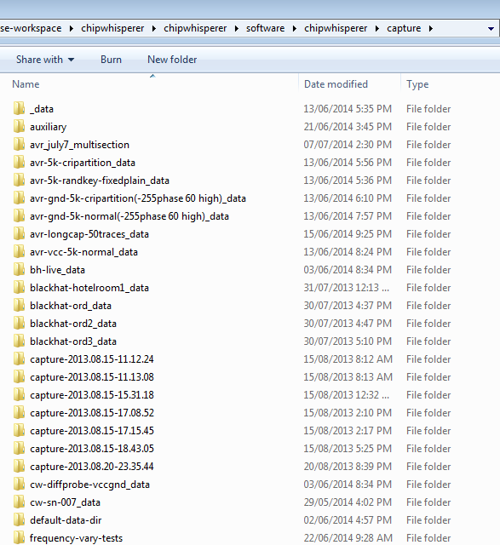
Data Directories
If you didn’t save a project before capture:
default-data-dir
If you saved a project before capture:
$projectname$_data

Slide 14
Wave Format
[Trace Config]
numTraces = 5000
format = native
numPoints = 3000
prefix = 2014.06.13-20.12.56_
date = 2014-06-13 20:12:56
scopeSampleRate = 0
notes = ""
scopeName = unknown
scopeXUnits = 0
targetSW = unknown
targetHW = unknown
scopeYUnits = 0
[Aux Data 0000 - Partition Randomly (debug)]
round = 0
filename = 2014.06.13-20.12.56_PartitionRandDebug_aux_0000.npy
[Aux Data 0001 - Partition Randomly (debug)]
round = 0
filename = 2014.06.13-20.12.56_PartitionRandDebug_aux_0001.npy

Slide 15
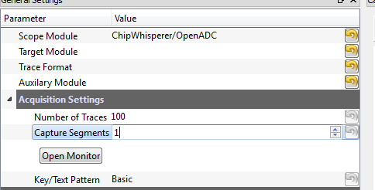
Wave Format
Wave files SAVED during capture
Project file made by linking all wave files into one project file
If capture crashes hopefully no or little data lost…
Determines how many files to write
Traces/File = NoTraces/CaptureSegments

Slide 16
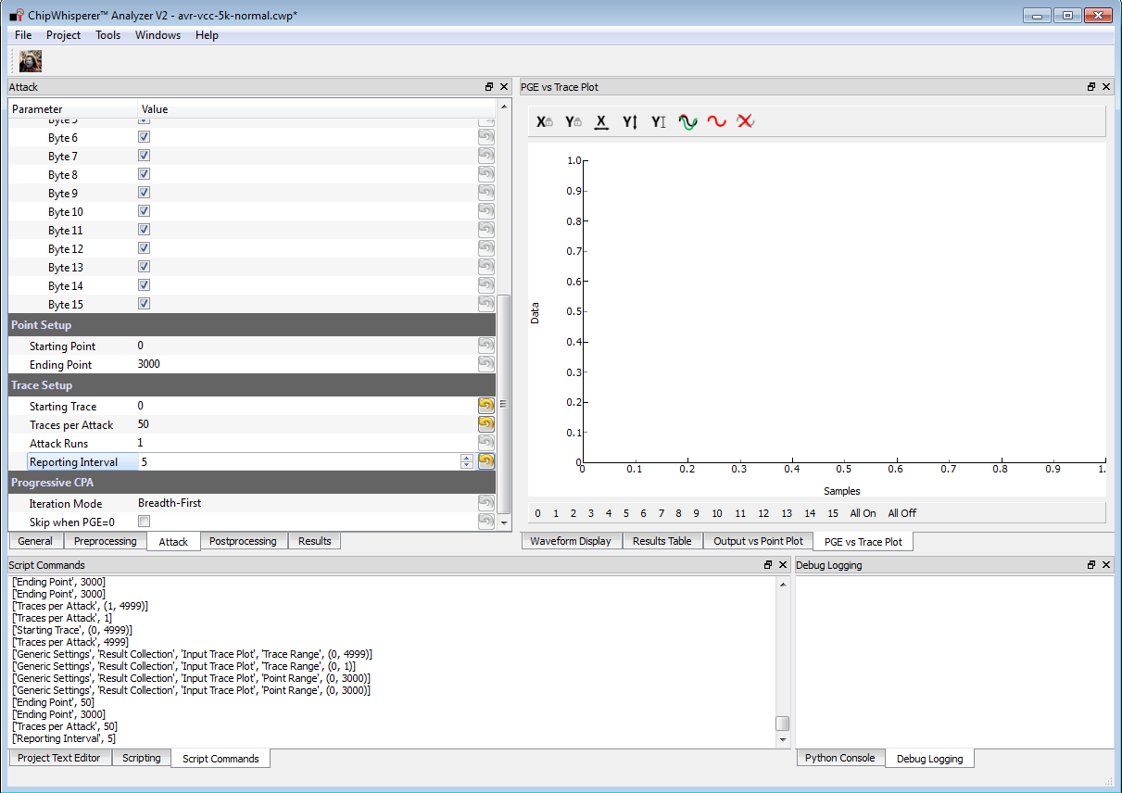
Scripting Some Files

Slide 17
Scripting Some Files
Open the file training_material\copy_paste\script_analyzer.py

Slide 18
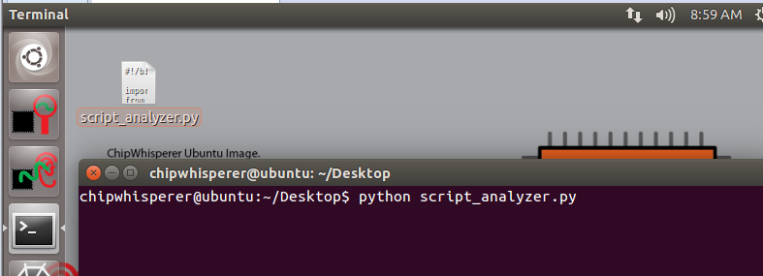
Scripting some Files
Copy to your Virtual Machine
Run the File

Slide 19
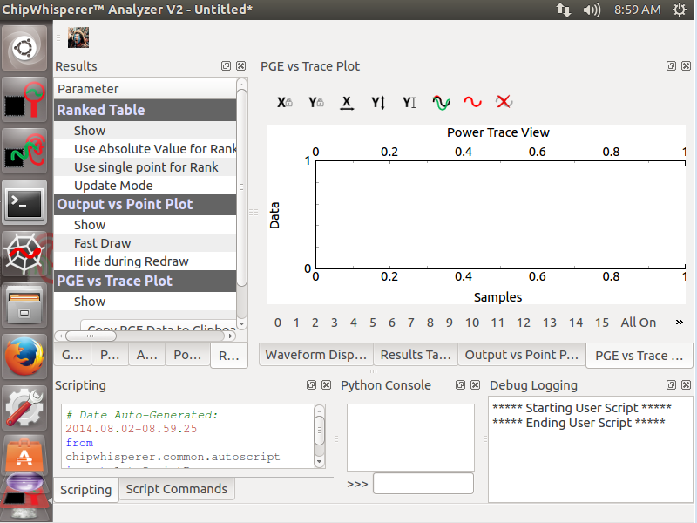
Like Magic!

Slide 20
Open a Project File…
#User commands here
print "***** Starting User Script *****"
ana.openProject("/home/chipwhisperer/example_traces/avr/avr-vcc-5k-normal.cwp")
pe()
print "***** Ending User Script *****"

Slide 21
Run some GUI Commands…
#User commands here
print "***** Starting User Script *****"
ana.openProject("/home/chipwhisperer/example_traces/avr/avr-vcc-5k-normal.cwp")
pe()
ana.setParameter(['Generic Settings', 'Result Collection', 'Input Trace Plot', 'Trace Range', (0, 10)])
ana.setParameter(['Generic Settings', 'Result Collection', 'Input Trace Plot', 'Redraw', None])
print "***** Ending User Script *****"

Slide 22
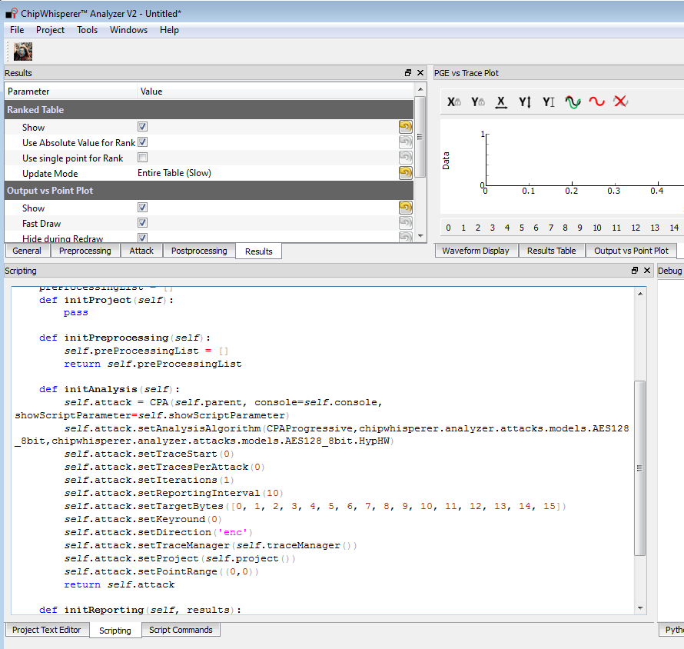
The Attack Script

Slide 23
Preprocessing Modules

Slide 24
More Scripting Examples…

Slide 25
Capture Software Architecture

Slide 26
FPGA Project Generation
#!/bin/sh
../../../../openadc/hdl/makeise/./makeise.py ztex_rev2_1.11c_ise.in ztex_rev2_1.11c_ise/ztex_rev2_1.11c_ise.xise
#
# Input file for OpenADC-MakeISE for the ChipWhisperer-CaptureRev2 Hardware
#
# OpenADC-MakeISE is a method of making ISE Project files automatically, and will eventually
# be extended to include command-line design flows. This saves the issue of dealing with changes
# in project files being added to git, especially if using different versions of ISE.
#
# WARNING: Everything is CASE SENSITIVE
#
[ISE Configuration]
#Generate project configuration
#You can specify any parameter here which will override the input file 'defaults'
InputFile = ise_verilog_template.xise.in
Version = 14.4
Device Family = Spartan6
Package = ftg256
Device = xc6slx25
Speed Grade = -3
Verilog Include Directories = ../../../hdl|../../../../../openadc/hdl/hdl
#This is needed to allow the partial bitstream files to be generated successfully
Other Map Command Line Options = -convert_bram8

Slide 27
FPGA Project Generation
[Setup File]
ZTEX
UART_CLK = 30000000
MAX_SAMPLES = 24573
FAST_FTDI
NOBUFG_ADCCLK
CLOCK_ADVANCED
SYSTEM_CLK = 30000000
TARG_UART_BAUD = 38400
HW_TYPE = 3
HW_VER = 0
#ENABLE_RECONFIG
#ENABLE_I2C

Slide 28
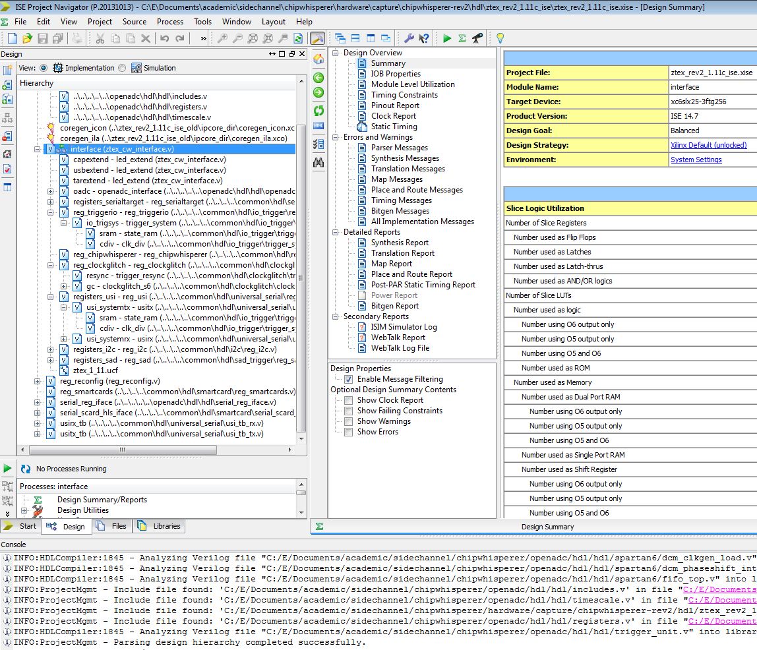
ChipWhisperer Main FPGA Project

Slide 29
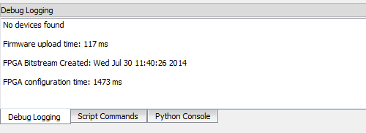
Generating Bitstreams + Partial Files
Bitstream location specified in GUI
Date printed on start-up, ensure it’s finding your new file!
Will have to unplug/replug CW first to clear old bitstream

Slide 30
Generating Bitstreams + Partial Files
If you want glitch generation, need to run the generate_reconfig_dicts.py script in chipwhisperer\hardware\capture\chipwhisperer-rev2\hdl
WARNING: Takes a long time
Then copy s6lx25-glitchwidth.p & s6lx25-glitchoffset.p to chipwhisperer\software\chipwhisperer\capture\scopes\cw-partial-files
CW-Capture uses timestamps to confirm partial files & bitstream are consistent (~within 8 hours). If not the partial reconfiguration is disabled & message printed

Slide 31
This training content is Copyright © NewAE Technology Inc. 2016. ChipWhisperer is a trademark of NewAE Technology Inc., registered in the United States of America and Europe. See terms and conditions at ChipWhisperer.io

